Slide 1
Using GPUs in Deep learning Frameworks
Ahmad Sheikhzada Computational Scientist E: jus2yw@virginia.edu
Jacalyn Huband Senior Computational Scientist E: jmh5d@virginia.edu

Slide 2
Topics
Overview of Deep Learning
Overview of GPUs
Tensorflow/Keras
Multi-Layer Perceptron (MLP)
Convolutional NN
PyTorch
MLP
Distributed Training
Multi-gpu data parallel example

Slide 3
Overview of Deep learning

Slide 4

https://www.edureka.co/blog/ai-vs-machine-learning-vs-deep-learning/

Slide 5
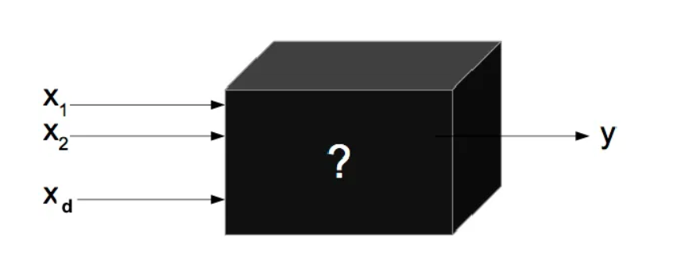
What is deep learning?
A branch of artificial intelligence where programs use multiple layers of neural networks to transform a set of input values to output values
Deep Neural Network

Slide 6
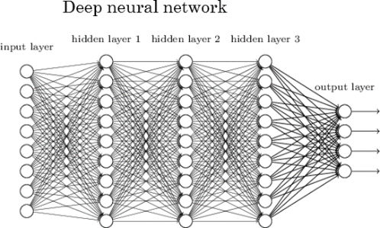
Deep Learning Neural Network
Deep Neural Network
Image borrowed from:
http://www.kdnuggets.com/2017/05/deep-learning-big-deal.html

Slide 7

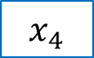
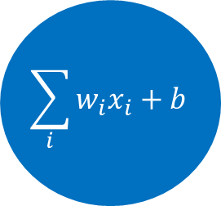





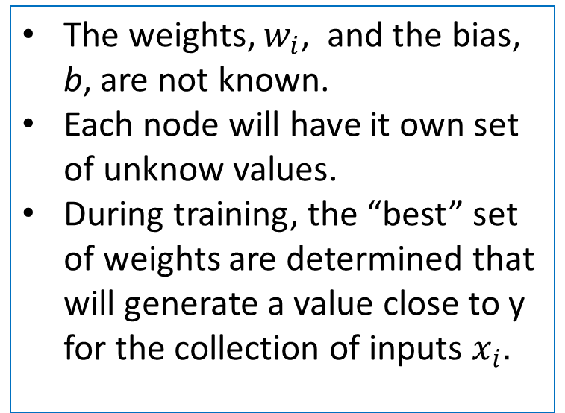

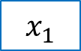


A Peek at a Node
Each “node” in the neural network performs a set of computations
The weights, $w_{i}$, and the bias, b, are not known.
Each node will have it own set of unknow values.
During training, the “best” set of weights are determined that will generate a value close to y for the collection of inputs $x_{i}.$
$$x_{1}$$
$$x_{2}$$
$$w_{1}$$
$$\sum_{i}{w_{i}x_{i}+b}$$
$$w_{2}$$
$$x_{3}$$
Activation function
$$w_{3}$$
$$\hat{y}$$
$$x_{4}$$
$$w_{4}$$
$$x_{5}$$
$$w_{5}$$

Slide 8
How does it learn?
During the training or “fitting” process, you feed into the Deep Learning algorithm a set of measurements/features and the expected outcome (e.g., a label or classification).
The algorithm determines the best weights and biases for the data.
Data Measurements
Deep Learning Algorithm
Model defining the relationship between the input and the output
Label or Classification

Slide 9
Overview of the Learning Process
Random guesses for the weights
Input Values
Run the data through the nodes to compute the output values
Predicted output
Compute the loss function & metrics
Tweak the weights
Output Values
Training Loop
Model that predicts output for given input

Slide 10
Activation Function
A function that will determine if a node should “fire”.
Examples include nn.ReLU, nn.Sigmoid, and nn.Softmax.
A complete list is available at
https://pytorch.org/docs/stable/nn.html#non-linear-activations-weighted-sum-nonlinearity
and
https://pytorch.org/docs/stable/nn.html#non-linear-activations-other

Slide 11
Loss Function
A function that will be optimized to improve the performance of the model.
Examples include nn.BCELoss (Binary CrossEntropy) and nn.CrossEntropyLoss.
A complete list is available at https://pytorch.org/docs/stable/nn.html#loss-functions

Slide 12
Optimizer functions
The function for tweaking the weights.
Examples include SGD, Adam, and RMSprop.
A complete list is available at https://pytorch.org/docs/stable/optim.html?highlight=optimizer#torch.optim.Optimizer

Slide 13
What about GPUs?
Because the training process involves hundreds of thousands of computations, we need a form of parallelization to speed up the process.
GPUs provide the needed parallelization.

Slide 14
GPU

Slide 15
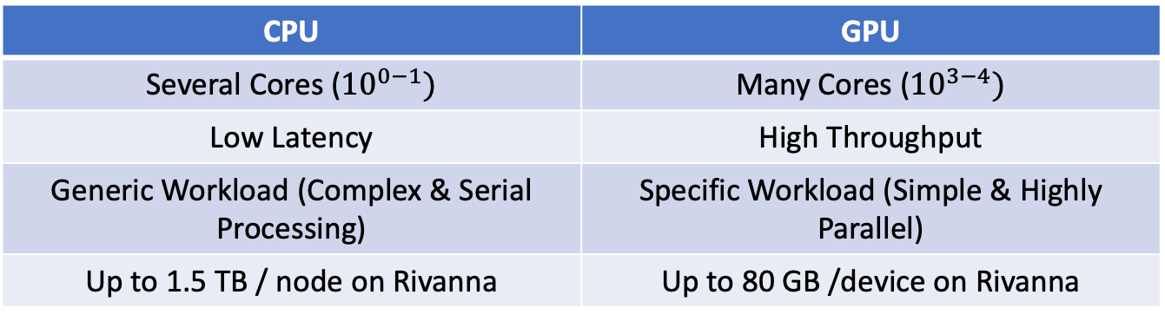
GPU: Overview
Graphics Processing Units (GPUs), originally developed for accelerating graphics rendering, can dramatically speed up any simple but highly parallel computational processes (General Purpose GPU).
GPU vs CPU
Integrated vs Discrete
Integrated mostly for graphics rendering and gaming
Dedicated GPUs designed for intensive computations
CPU | GPU
Several Cores (${10}^{0−1})$ | Many Cores (${10}^{3−4})$
Low Latency | High Throughput
Generic Workload (Complex & Serial Processing) | Specific Workload (Simple & Highly Parallel)
Up to 1.5 TB / node on Rivanna | Up to 80 GB /device on Rivanna

Slide 16
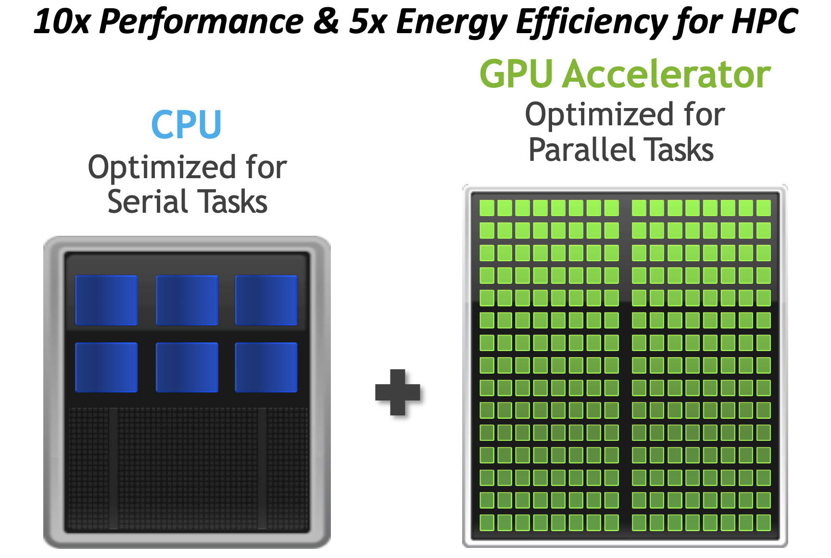
Credit: NVIDIA

Slide 17
GPU: Overview
Vendors & Types
NVIDIA, AMD, Intel
Datacenter : K80, P100, V100, A100, H100
Workstations: A6000, Quadro
Gaming: GeForce RTX 20xx, 30xx, 40xx
CUDA vs OpenCL (Make GPUs programmable)
CUDA is parallel computation platform, developed by NVIDIA, allows software to run on both CPU and GPU
OpenCL: More general parallel computing platform, developed by Apple, allows software to access CPUs, GPUs, FPGAs etc.
Both are compatible with Python, but most GPU-enabled Python libraries will only work with NVIDIA GPUs.

Slide 18
Terminology: Computational Graphs
Computational graphs help to break down computations.
For example, the graph for y=(x1+x2)*(x2 - 5) is
x1
a = x1 + x2
The beauty of computational graphs is that they show where computations can be done in parallel.
y = a*b
x2
b = x2 - 5

Slide 19
GPUs in DL
With deep learning models, you can have hundreds of thousands of computational graphs.
A GPU can perform a thousand or more of the computational graphs simultaneously. This will speed up your program significantly.
New GPUs have been developed and optimized specifically for deep learning.
All the major deep learning Python libraries (Tensorflow, PyTorch, Keras, Caffe,…) support the use of GPUs and allow users to distribute their code over multiple GPUs.

Slide 20
GPUs in DL …
Scikit-learn does not support GPU processing.
Deep learning acceleration is furthered with Tensor Cores in NVIDIA GPUs.
Tensor Cores accelerate large matrix operations by performing mixed-precision computing.
Accelerates math, Reduces the memory traffic and consumption.
If you’re not using a neural network as your machine learning model you may find that a GPU doesn’t improve the computation time.
If you are using a neural network but it is very small then a GPU will not be any faster than a CPU - in fact, it might even be slower.

Slide 21
Rivanna-NVIDIA DGX BasePOD
10 DGX A100 nodes
8 NVIDIA A100 GPUs.
80 GB GPU memory options.
Dual AMD EPYC™ 7742 CPUs, 128 total cores, 2.25 GHz (base), 3.4 GHz (max boost).
2 TB of system memory.
Two 1.92 TB M.2 NVMe drives for DGX OS, eight 3.84 TB U.2 NVMe drives for storage/cache.
Advanced Features:
NVLink for fast multi-GPU communication
GPUDirect RDMA Peer Memory for fast multi-node multi-GPU communication
GPUDirect Storage with 200 TB IBM ESS3200 (NVMe) SpectrumScale storage array
Ideal Scenarios:
Job needs multiple GPUs on a single node or multi node
Job (single or multi-GPU) is I/O intensive
Job (single or multi-GPU) requires more than 40GB of GPU memory

Slide 22
GPU access on Rivanna
POD nodes are contained in the gpu partition with a specific Slurm constraint.
Slurm script:
#SBATCH -p gpu
#SBATCH --gres=gpu:a100:X # X number of GPUs
#SBATCH -C gpupod
Open OnDemand
--constraint=gpupod

Slide 23
TensorFlow

Slide 24
What is TensorFlow?
An example of deep learning; a neural network that has many layers.
A software library, developed by the Google Brain Team.
TensorFlow already has the code to assign the data to the GPUs and do the heavy computational work; we simply have to give it the specifics for our data and model.
Keras is an open-source deep learning library in Python that provides an easy-to-use interface to TensorFlow.
tf.keras is the Keras API integrated into TensorFlow 2

Slide 25
Terminology: Tensors
Tensor: A multi-dimensional array
Example: A sequence of images can be represented as a 4-D array: [image_num, row, col, color_channel]
+ Tensors can be used on a GPU
Px_value[1, 1, 3, 2]=1
Image #0
Image #1

Slide 26
Coding a TensorFlow

Slide 27
Coding Tensor Flow: General Steps
Import Modules
Read in the data
Divide the data into a training set and a test set.
Preprocess the data
Design the Network Model
Train the model- Compile, Checkpointing, EarlyStopping and Fitting
Apply the model to the test data and display the results
Loading a checkpointed model

Slide 28
1. Import Modules
from tensorflow.keras import Sequential
from tensorflow.keras.layers import Dense, Dropout
from tensorflow.keras.utils import to_categorical
from tensorflow.keras.optimizers import SGD

Slide 29
2. Read in the Data
import numpy as np
data_file = 'Data/cancer_data.csv'
target_file = 'Data/cancer_target.csv'
cancer_data=np.loadtxt(data_file,dtype=float,
delimiter=',')
cancer_target=np.loadtxt(target_file, dtype=float, delimiter=',')

Slide 30
3. Split the Data
from sklearn import model_selection
test_size = 0.30
seed = 7
train_data, test_data, train_target, test_target = model_selection.train_test_split(cancer_data,cancer_target, test_size=test_size,
random_state=seed)

Slide 31
4. Pre-process the Data
from sklearn.preprocessing import StandardScaler
scaler = StandardScaler()
# Fit only to the training data
scaler.fit(train_data)
# Now apply the transformations to the data:
x_train = scaler.transform(train_data)
x_test = scaler.transform(test_data)
# Convert the classes to ‘one-hot’ vector
y_train = to_categorical(train_target, num_classes=2)
y_test = to_categorical(test_target, num_classes=2)

Slide 32
5. Design the Model
model = Sequential()
model.add(Dense(30, activation='relu', input_dim=30))
model.add(Dropout(0.5))
model.add(Dense(60, activation='relu'))
model.add(Dropout(0.5))
model.add(Dense(2, activation='softmax'))
print(model.summary())

Slide 33
6.1 Compile the Model
sgd = SGD(learning_rate=0.01, decay=1e-6, momentum=0.9, nesterov=True)
model.compile(loss='categorical_crossentropy', optimizer=sgd, metrics=['accuracy'])

Slide 34
6.2 Checkpointing and Earlystopping
filepath="weights.best.hdf5”
checkpoint = ModelCheckpoint(filepath, monitor='val_accuracy', verbose=0, save_best_only=True, mode='max')
es = EarlyStopping(monitor='val_accuracy', patience=5)
callbacks_list = [checkpoint, es]

Slide 35
6.3 Fit and Save the Model
b_size = int(.8*x_train.shape[0])
history = model.fit(x_train, y_train, validation_split=0.33, epochs=300, batch_size=b_size, callbacks=callbacks_list, verbose=1)
model.save('model.h5')

Slide 36
6.4 Plot the Learning Curves
plt.title('Learning Curves')
plt.xlabel('Epoch')
plt.ylabel('Cross Entropy')
plt.plot(history.history['loss'], label='train')
plt.plot(history.history['val_loss'], label='val')
plt.legend()
plt.show()

Slide 37
7. Apply the Model to Test Data and Evaluate
predictions = np.argmax(model.predict(x_test), axis=-1)
score = model.evaluate(x_test, y_test, batch_size=b_size)
print('\nAccuracy: %.3f' % score[1])
from sklearn.metrics import confusion_matrix
print(confusion_matrix(test_target, predictions))

Slide 38
8.1 Loading a Checkpointed NN Model
# This assumes you already know the structure of the NN model since checkpointing only saves the weights.
model_2 = Sequential()
model_2.add(Dense(30, activation='relu', input_dim=30))
model_2.add(Dropout(0.5))
model_2.add(Dense(60, activation='relu'))
model_2.add(Dropout(0.5))
model_2.add(Dense(2, activation='softmax'))
# load weights
model_2.load_weights("weights.best.hdf5")
# Compile model (required to make predictions)
model_2.compile(loss='categorical_crossentropy', optimizer=sgd, metrics=['accuracy'])
# estimate accuracy on whole dataset using loaded weights
scores = model_2.evaluate(x_test, y_test, verbose=0)
print("%s: %.2f%%" % (model_2.metrics_names[1], scores[1]*100))

Slide 39
8.2 Loading a Saved Model
from tensorflow.keras.models import load_model
model_3 = load_model('model.h5')
row_3 = x_test[-100].reshape((1,-1))
prediction_3 = np.argmax(model.predict(row_3), axis=-1)
print(prediction_3)

Slide 40
Activity: TensorFlow Program
Make sure that you can run the TensorFlow code:
Python
Py_ex2_TensorFlow.ipynb

Slide 41
Convolutional Neural Networks

Slide 42
What are Convolutional Neural Networks?
Originally, convolutional neural networks (CNNs) were a technique for analyzing images.
Applications have expanded to include analysis of text, video, and audio.
CNNs apply multiple neural networks to subsets of a whole image in order to identify parts of the image.

Slide 43
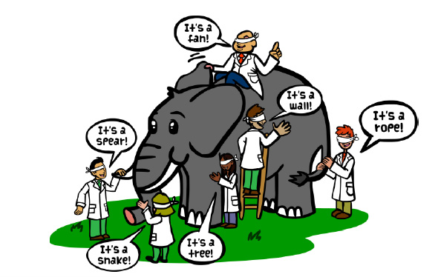
The Idea behind CNN
Recall the old joke about the blind-folded scientists trying to identify an elephant.
A CNN works in a similar way. It breaks an image down into smaller parts and tests whether these parts match known parts.
It also needs to check if specific parts are within certain proximities.
For example, the tusks are near the trunk and not near the tail.
Image borrowed from https://tekrighter.wordpress.com/2014/03/13/metabolomics-elephants-and-blind-men/

Slide 44
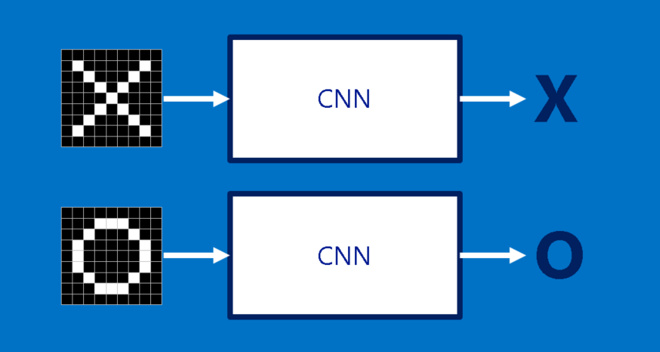
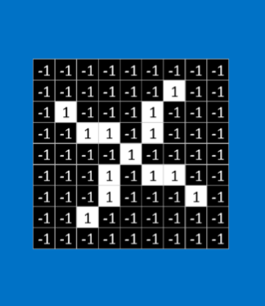
Is the image on the left most like an X or an O?
Images borrowed from
http://brohrer.github.io/how_convolutional_neural_networks_work.html

Slide 45
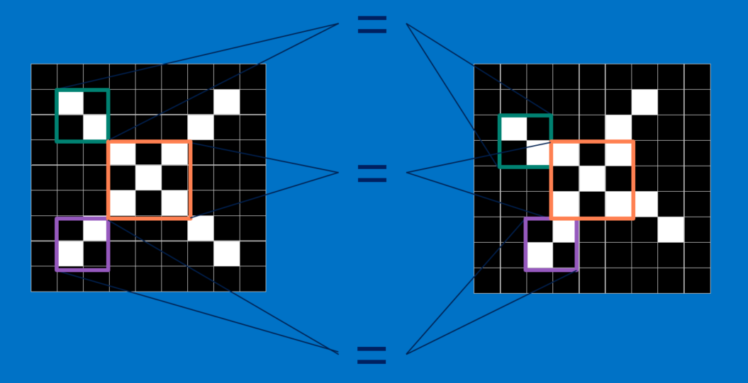
What features are in common?

Slide 46
Building Blocks of CNN
CNN performs a combination of layers
Convolution Layer
Compares a feature with all subsets of the image
Creates a map showing where the comparable features occur
Rectified Linear Units (ReLU) Layer
Goes through the features maps and replaces negative values with 0
Pooling Layer
Reduces the size of the rectified feature maps by taking the maximum value of a subset
And ends with a final layer
Classification (Fully-connected layer) layer
Combines the specific features to determine the classification of the image

Slide 47
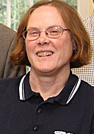
Steps
.
.
.
Convolution Rectified Linear Pooling
These layer can be repeated multiple times.
The final layer converts the final feature map to the classification.
{

Slide 48
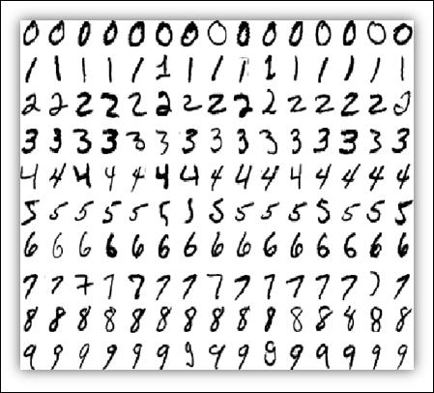
Example: MNIST Data
The MNIST data set is a collection of hand-written digits (e.g., 0 – 9).
Each digit is captured as an image with 28x28 pixels.
The data set is already partitioned into a training set (60,000 images) and a test set (10,000 images).
The tensorflow packages have tools for reading in the MNIST datasets.
More details on the data are available at http://yann.lecun.com/exdb/mnist/
Image borrowed from
Getting Started with TensorFlow by Giancarlo Zaccone

Slide 49
Coding CNN: General Steps
Load the data
Preprocess the data.
2a. Capture the sizes
2b. Reshape the data
Design the Network Model
Train the model
Apply the model to the test data
Display the results
Good example code: https://machinelearningmastery.com/tensorflow-tutorial-deep-learning-with-tf-keras/

Slide 50
1. Load the Data
(X_train, Y_train), (X_test, Y_test) = mnist.load_data()
for i in range(9):
plt.subplot(330 + 1 + i)
plt.imshow(X_train[i], cmap=plt.get_cmap('gray'))
plt.show()

Slide 51
2a. Pre-process the Data: Capture the sizes
numTrain = X_train.shape[0]
numTest = X_test.shape[0]
numRows = X_train.shape[1]
numCols = X_train.shape[2]
labels = set(Y_train)
input_size = numRows * numCols
numLabels = len(labels)
np.random.seed(1234) #for reproducibility

Slide 52
2b. Pre-process the Data: Reshape
X_train = X_train.reshape(numTrain, numRows, numCols, 1)
X_test = X_test.reshape(numTest, numRows, numCols, 1)
# Scale values
X_train = X_train.astype('float32')/255
X_test = X_test.astype('float32')/255
# Convert labels to ‘one-hot’ vectors
Y_train = to_categorical(Y_train, numLabels)
Y_test = to_categorical(Y_test, numLabels)

Slide 53
3. Design the Network model 1/2
# Set up model for tensorflow
model = Sequential()
# First Convolution Layer
model.add(Convolution2D(filters=32, kernel_size=(3,3), activation='relu', kernel_initializer='he_uniform', input_shape=(numRows, numCols, 1)))
model.add(MaxPooling2D(pool_size=(2,2)))
model.add(Conv2D(64, (3, 3), activation='relu', kernel_initializer='he_uniform'))
model.add(Conv2D(64, (3, 3), activation='relu', kernel_initializer='he_uniform'))
model.add(MaxPooling2D((2, 2)))
model.add(Dropout(0.25))
model.add(Flatten())

Slide 54
3. Design the Network model 2/2
# Fully Connected Layer
model.add(Dense(units=200, activation='relu'))
# Output Layer
model.add(Dense(numLabels, activation='softmax’))
model.compile(optimizer='adam', loss='categorical_crossentropy', metrics=['accuracy'])

Slide 55
4. Train the model
model.fit(X_train, Y_train, batch_size=100, epochs=8, validation_split = 0.1, verbose=1)
score = model.evaluate(X_train, Y_train, verbose=1)
print('\nTrain accuracy:', score[1])

Slide 56
5. Apply Model to Test Data
loss, score = model.evaluate(X_test, Y_test, verbose=1)
print('\nTest accuracy:', score)

Slide 57
Activity: CNN Program
Make sure that you can run the CNN code:
Python
Py_ex3_CNN.ipynb

Slide 58
PyTorch

Slide 59
What is PyTorch?
Another widely-used deep learning platform known for its flexibility and speed.
A software library, developed by Facebook and maintained by Mega AI.
Torch is an open-source project for DL written in C and generally used via the Lua interface. Torch is no longer actively developed but libraries are used in Pytorch.

Slide 60
Overview of PyTorch
Because PyTorch and Tensorflow use some common underlying codes, many of the required functions (e.g., activation, loss, optimizer) will be the same.
Popular library used by academics and researchers.

Slide 61
Torch Tensors
Tensor: multidimensional array (just like numpy ndarray) + can be used on GPUs
import torch
x = torch.rand(5,3, dtype=torch.long, device=‘cuda’) # if not specified, uses cpu
y = torch.zeros(5,3)
z = torch.add(x+y) # or z=x+y
w = z.numpy() # convert to numpy array, same memory location
t = torch.from_numpy(w) # numpy to torch tensor (on cpu)

Slide 62
Torch Tensors…
CUDA tensors
Tensors can be moved onto any device using the .to method.
if torch.cuda.is_available():
device = torch.device("cuda")
y = torch.rand(3,5, device=device)
x = torch.rand(3,5).to(device)
z = x + y
print(z)
print(z.to("cpu", torch.double)) # ``.to`` can also change dtype together!

Slide 63
Coding a PyTorch Example

Slide 64
Coding Pytorch: General Steps
Import the torch package
Read in the data
Preprocess the data
3a. Scale the data
3b. Split the data
3c. Convert data to tensors
3d. Load the tensors
Design the Network Model
Define the Learning Process
Train the model
Apply the model to the test data
Display the results

Slide 65
1. Import torch Package
import torch
if torch.cuda.is_available():
device_type = "cuda:" +
str(torch.cuda.current_device())
else:
device_type = "cpu"
device = torch.device(device_type)

Slide 66
2. Read in the Data
import numpy as np
data_file = ‘Data/cancer_data.csv'
target_file = ‘Data/cancer_target.csv'
x=np.loadtxt(data_file,dtype=float,delimiter=',')
y=np.loadtxt(target_file, dtype=float, delimiter=',')
print("shape of x: {}\nshape of y: {}".format(x.shape,y.shape))

Slide 67
3a. Scale the data
#feature scaling
from sklearn.preprocessing import StandardScaler
sc = StandardScaler()
x = sc.fit_transform(x)

Slide 68
3b. Split the Data
from sklearn import model_selection
test_size = 0.30
seed = 7
train_data, test_data, train_target, test_target = model_selection.train_test_split(x, y, test_size=test_size, random_state=seed)

Slide 69
3c. Convert data to tensors
#defining dataset class
from torch.utils.data import Dataset
class dataset(Dataset):
def __init__(self,x,y):
self.x = torch.tensor(x,dtype=torch.float32)
self.y = torch.tensor(y,dtype=torch.float32)
self.length = self.x.shape[0]
def __getitem__(self,idx):
return self.x[idx],self.y[idx]
def __len__(self):
return self.length
trainset = dataset(train_data,train_target)

Slide 70
3d. Load the tensors
#DataLoader
from torch.utils.data import DataLoader
trainloader = DataLoader(trainset,batch_size=64,shuffle=False)

Slide 71
4. Design the Network Model
from torch import nn
class Net(nn.Module):
def __init__(self,input_shape):
super(Net,self).__init__()
self.fc1 = nn.Linear(input_shape,32)
self.fc2 = nn.Linear(32,64)
self.fc3 = nn.Linear(64,1)
def forward(self,x):
x = torch.relu(self.fc1(x))
x = torch.relu(self.fc2(x))
x = torch.sigmoid(self.fc3(x))
return x
model = Net(input_shape=x.shape[1])

Slide 72
5. Define the Learning Process
learning_rate = 0.01
epochs = 700
optimizer = torch.optim.SGD(model.parameters(),
lr=learning_rate)
loss_fn = nn.BCELoss()

Slide 73
6. Fit the Model
losses = []
accur = []
for i in range(epochs):
for j,(x_train,y_train) in enumerate(trainloader):
#calculate output
output = model(x_train)
#calculate loss
loss = loss_fn(output,y_train.reshape(-1,1))
#accuracy
predicted = model(torch.tensor(x,dtype=torch.float32))
acc = (predicted.reshape(-1).detach().numpy().round() == y).mean()
#backprop
optimizer.zero_grad()
loss.backward()
optimizer.step()
if i%50 == 0:
losses.append(loss)
accur.append(acc)
print("epoch {}\tloss : {}\t accuracy : {}".format(i,loss,acc))

Slide 74
7. Apply the Model to Test Data
testset = dataset(test_data,test_target)
trainloader = DataLoader(testset,batch_size=64,shuffle=False)
predicted = model(torch.tensor(test_data,dtype=torch.float32))

Slide 75
8. Evaluate the Results
acc = (predicted.reshape(-1).detach().numpy().round() == test_target).mean()
print('\nAccuracy: %.3f' % acc)
from sklearn.metrics import confusion_matrix
predicted = predicted.reshape(-1).detach().numpy().round()
print(confusion_matrix(test_target, predicted))

Slide 76
Activity: PyTorch Program
Make sure that you can run the PyTorch code:
Python
Py_ex4_PyTorch.ipynb

Slide 77
Distributed training

Slide 78
Need for Parallelism
Distributed training is imperative for larger and more complex models/datasets
Data parallelism is a relatively simple and effective way to accelerate training

Slide 79
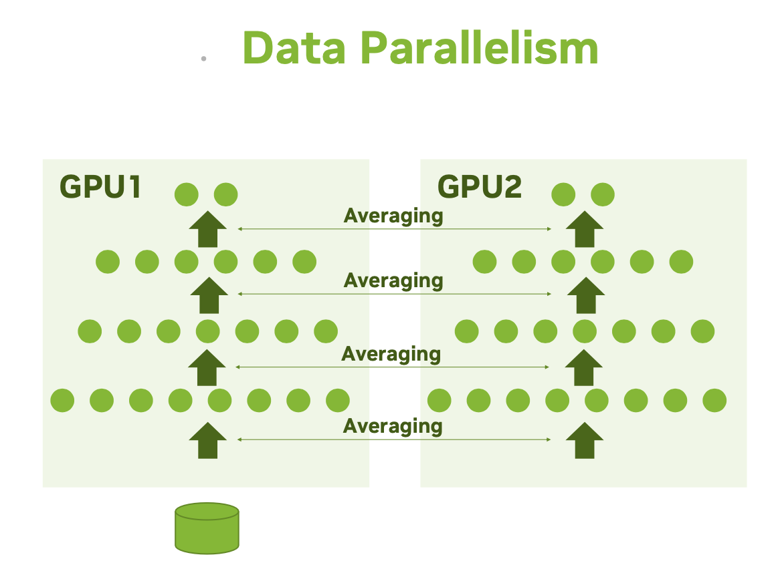
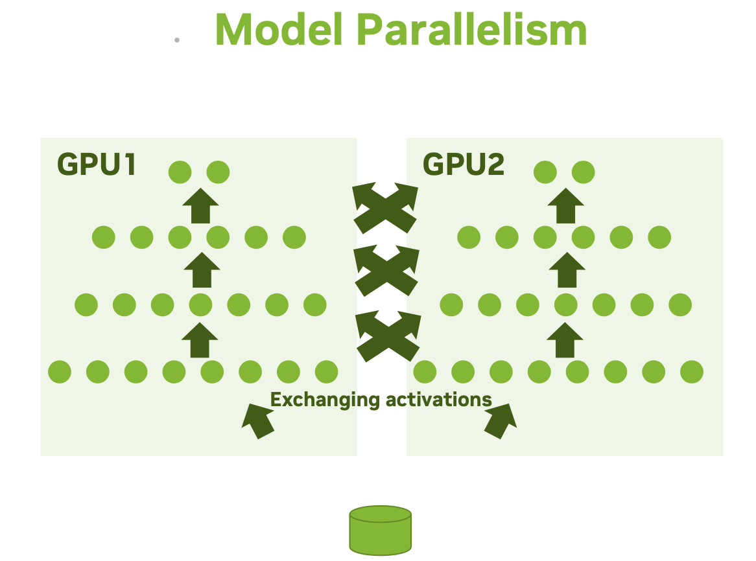
Parallelism Types

Slide 80
Data vs Model Parallelism
Data Parallelism
Model Parallelism
Allows to speed up training
All workers train on different data
All workers have the same copy of the model
Neural network gradients (weight changes) are exchanged
Allows for a bigger model
All workers train on the same data
Parts of the model are distributed across GPUs
Neural network activations are exchanged

Slide 81
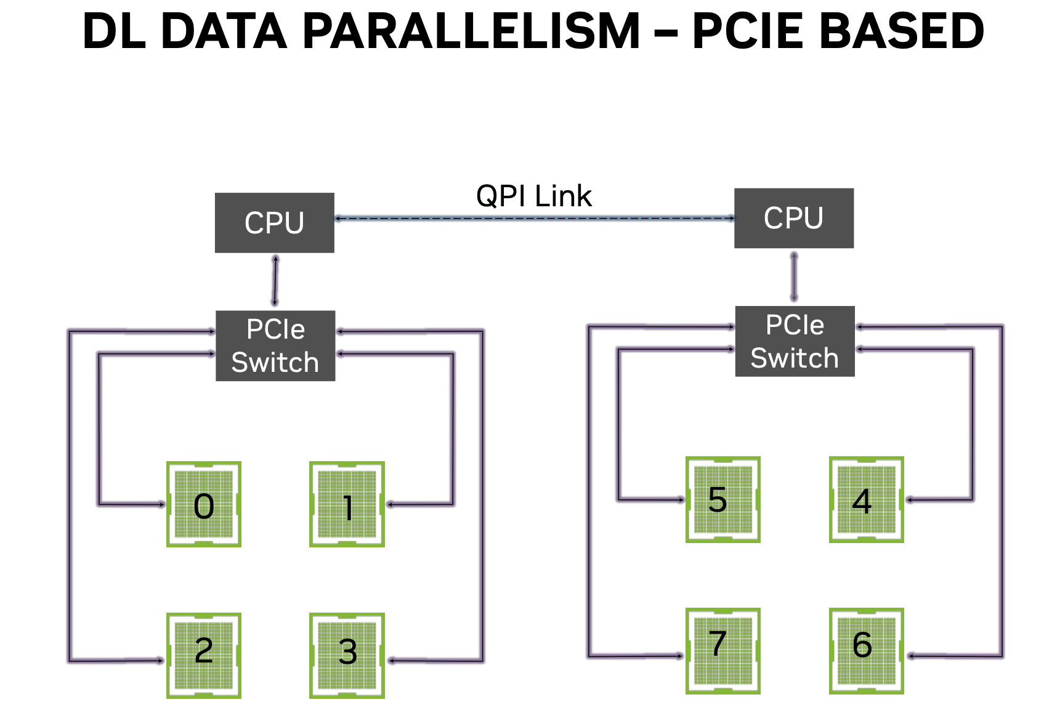
Datal loading and gradient averaging share communication resources → congestion

Slide 82
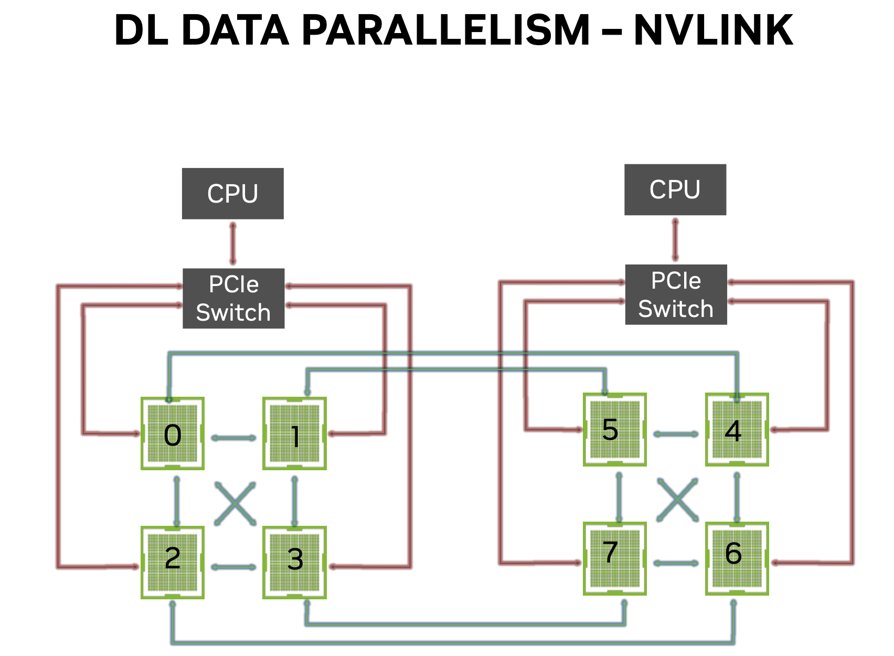
Datal loading on PCIe, gradient averaging on NVLINK → no congestion

Slide 83
Example: synchronous data parallelism

Slide 84
Single Host, Multi GPUs
Each device will run a copy of your model (called a replica).
At each step of training:
The current batch of data (called global batch) is split into e.g., 4 different sub-batches (called local batches).
Each of the 4 replicas independently processes a local batch; forward pass, backward pass, outputting the gradient of the weights.
The weight updates from local gradients are merged across the 4 replicas.

Slide 85
Coding: General Steps
Design the Model
Read in the data (recommended to use tf.data)
Create a Mirrored Strategy
Open a Strategy Scope
Train the Model
Evaluate the Model
Display the results

Slide 86
1. Design the Model
def get_compiled_model():
# Make a simple 2-layer densely-connected neural network.
inputs = keras.Input(shape=(784,))
x = keras.layers.Dense(256, activation="relu")(inputs)
x = keras.layers.Dense(256, activation="relu")(x)
outputs = keras.layers.Dense(10)(x)
model = keras.Model(inputs, outputs)
model.compile(
optimizer=keras.optimizers.Adam(),
loss=keras.losses.SparseCategoricalCrossentropy(from_logits=True),
metrics=[keras.metrics.SparseCategoricalAccuracy()],
)
return model

Slide 87
2.1 Read in the Data
def get_dataset():
batch_size = 32 # global batch size = batch_size_per_replica (depending on memory of each GPU) * # gpus
num_val_samples = 10000
# Return the MNIST dataset in the form of a `tf.data.Dataset`.
(x_train, y_train), (x_test, y_test) = keras.datasets.mnist.load_data()

Slide 88
2.2 Preprocess the Data
# Preprocess the data (these are Numpy arrays)
x_train = x_train.reshape(-1, 784).astype("float32") / 255
x_test = x_test.reshape(-1, 784).astype("float32") / 255
y_train = y_train.astype("float32")
y_test = y_test.astype("float32")

Slide 89
2.3 Prepare Data as tf.data Objects
# Reserve num_val_samples samples for validation
x_val = x_train[-num_val_samples:]
y_val = y_train[-num_val_samples:]
x_train = x_train[:-num_val_samples]
y_train = y_train[:-num_val_samples]
return (
tf.data.Dataset.from_tensor_slices((x_train, y_train)).batch(batch_size),
tf.data.Dataset.from_tensor_slices((x_val, y_val)).batch(batch_size),
tf.data.Dataset.from_tensor_slices((x_test, y_test)).batch(batch_size),
)

Slide 90
3. Create a Strategy
# Create a MirroredStrategy.
strategy = tf.distribute.MirroredStrategy()
print("Number of devices: {}".format(strategy.num_replicas_in_sync))

Slide 91
4. Open the Strategy Scope
# Open a strategy scope.
with strategy.scope():
model = get_compiled_model()

Slide 92
5. Train the Model
# Train the model on all available devices.
train_dataset, val_dataset, test_dataset = get_dataset()
model.fit(train_dataset, epochs=2, validation_data=val_dataset, verbose=1)

Slide 93
6. Evaluate the Model on Test Data
# Test the model on all available devices.
model.evaluate(test_dataset)

Slide 94
Activity: Distributed Pytorch Program
Make sure that you can run the PyTorch code:
Python
Py_ex5_DistributedTraining.ipynb

Slide 95
7. Remarks
Before running on multiple nodes, please make sure the job can scale well to 8 GPUs on a single node.
Multi-node jobs on the POD should request all GPUs on the nodes, i.e. --gres=gpu:a100:8.
You may have already used the POD by simply requesting an A100 node without the constraint, since 10 out of the total 12 A100 nodes are POD nodes.

Slide 96
Effective Use of HPC for DL
Start with an appropriate model which trains on a single CPU or GPU
Optimize single-node/single-GPU performance
Using performance analysis tools
Tuning and optimizing data pipeline
Make effective use of the hardware (e.g. mixed precision)
Distribute the training across multiple processors
Multi-GPU, multi-node data-parallel or model-parallel training
Optimize distributed performance
Use best optimized libraries for communications

Slide 97
Need more help?
Office Hours via Zoom
Tuesdays: 3 pm - 5 pm
Thursdays: 10 am - noon
Zoom Links are available at https://www.rc.virginia.edu/support/#office-hours
Website:
https://rc.virginia.edu

Slide 98
Questions?

